Slide 1
H2O-1B Safe Water for 1 Billion People
WHO WE ARE?
Amy Smith
Victor Grau Serrat
Susan Murcott
http://dlab.mit.edu and http://web.mit.edu/watsan

Slide 2
H2O-1B Safe Water for 1 Billion People
KEY STRENGTHS
ENGINEERING: We are trained in environmental, electrical and mechanical engineering.
RESEARCH: We head up research programs at MIT, a world–class research institution.
INNOVATION: We are innovators and teach innovation and design.
EXPERIENCE: The three of us have 50+ years of collective developing country experience in more than 30 countries, including 11 of the 20 SEH priority countries.
MODEL: We practice collaborative development through social business and entrepreneurship models

Slide 3
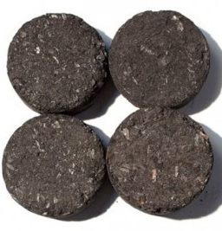
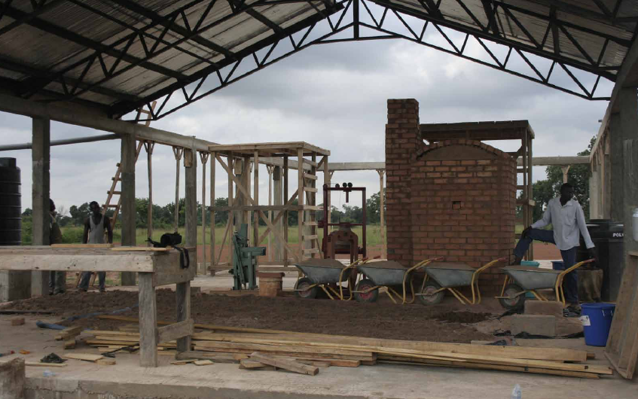
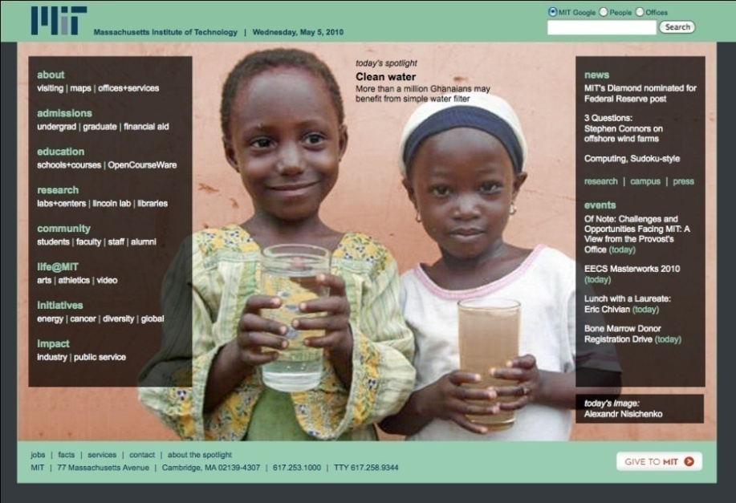
H2O-1B Safe Water for 1 Billion People
Promising Countries for our Team
Cambodia
Ghana
Guatemala
Nepal
Uganda

